Slide 1
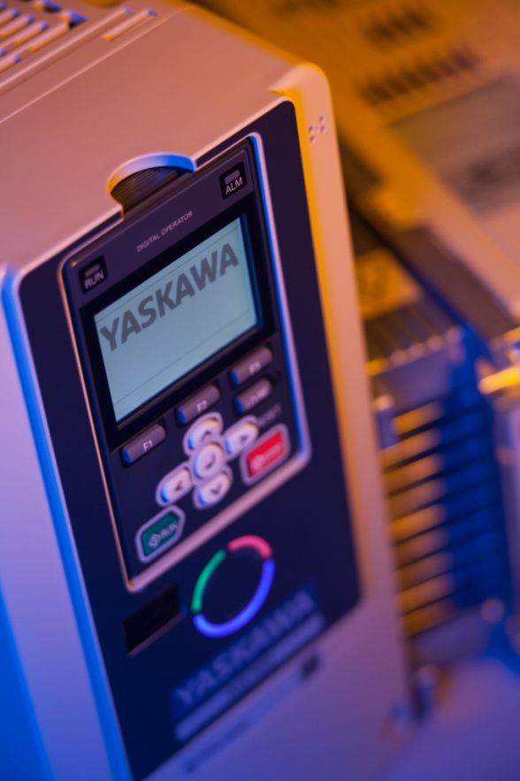
Introduction Driveworks EZ
Jan Plender
Application engineer Yaskawa Benelux

Slide 2
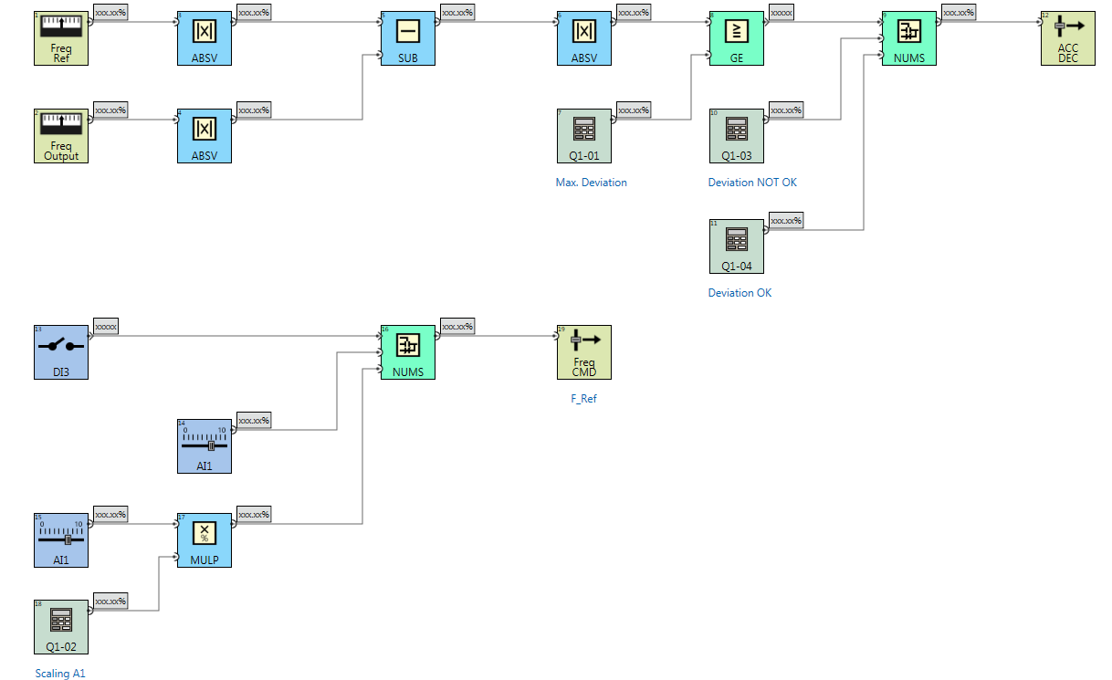
Drive works EZ - Webinar
Main purpose
Area of application
Programming environment
Case study
Live demo

Slide 3
Drive works EZ
Implementation of simple PLC functionality into the V1000, U1000, A1000, GA700 and GA500
Replace PLC
Drag-and-Drop programming
Easy programming. No high-level programming language knowledge necessary.
Customer know-how protection
Projects can be modified and copied to inverter by DriveWorks EZ license owner only

Slide 4
areas of application
Decentralized technology
Limits data exchange
Process level control
Stand alone machines
Emergency handling
Encoder line break
Bus communication failure
Custom functions / calculations
Virtual encoder
Pump sequence

Slide 5
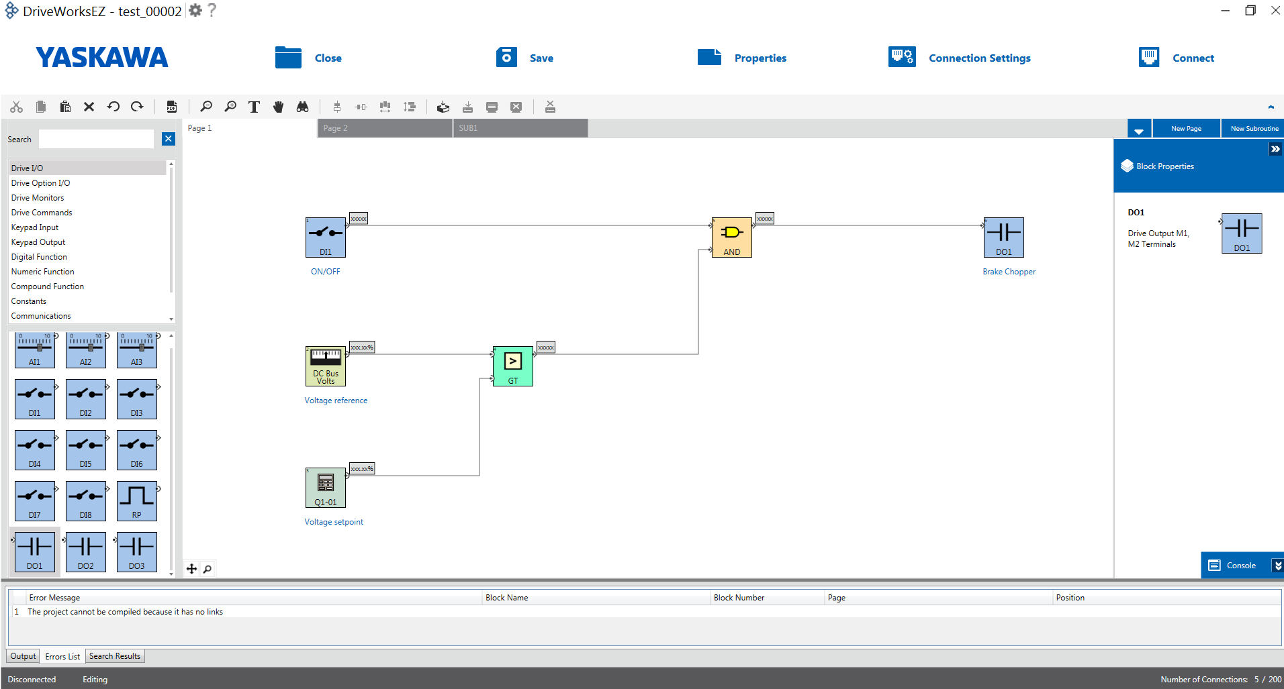
Main Window of DwEZ
Project Toolbar
Block Properties Window
Compile Output Window
Block selection Window
Programm Window

Slide 6
DWEZ 10 at a glance
DWEZ 10 Pro GA700
max. 200 connections
Adjustable Cycle time
Virtual DI DO AI AO
30 User Parameters
30 User Monitors
Multiple User in one Installation
Direct PDF export
Notes:
License from 1000series DWEZ possible to use for new Generation.

Slide 7
Scan time of DWEZ
Scan time of DWEZ program can be adjusted (Factory Access Level) for  00 : Drive Scan Time * 1 = 500 µs {Number of connections reduced}  01 : Drive Scan Time * 2 = 1000 µs [Default] {Timing equivalent to A1000}  02 : Drive Scan Time * 4 = 2000 µs {Timing equivalent to V1000}
Notes:
To maintain the timing of a DWEZ program written for ...
- A1000 set A1-10 = 1
- V1000 set A1-10 = 2

Slide 8
New functions of DWEZ 10 GA700/500
Memobus READ and Write Function
Full control of all Drive Registers
Read Bits and Registers
Write Bits and Registers
Send Enter Command (ROM or RAM)

Slide 9
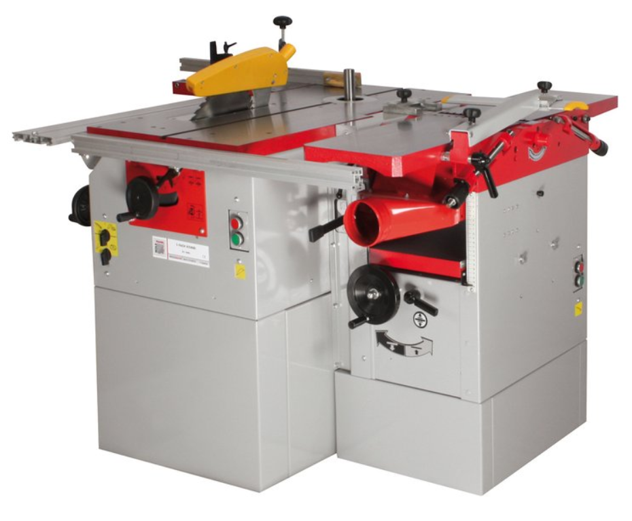
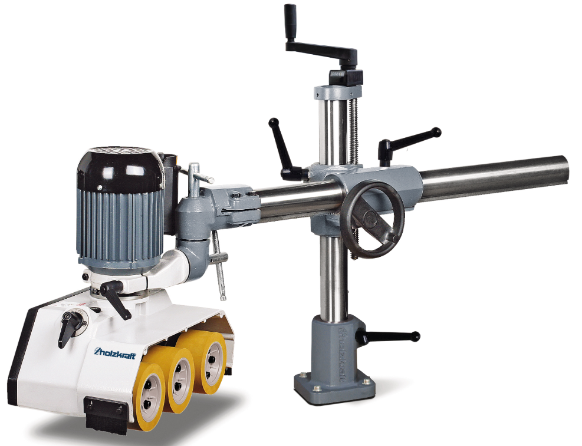
DWEZ Programming ChallEnge
Circular Saw, controlled by GA700
An extension with an electrical feeder controlled by GA500

Slide 10
DWEZ Programming
The Saw (GA700) is controlled by Digital inputs and Analog inputs.
The Feeder (GA500) should be controlled by the GA700 via Memobus (Gateway Mode).
To control the Gateway mode without PLC it is necessary to use the Memobus Write Functions.

Slide 11
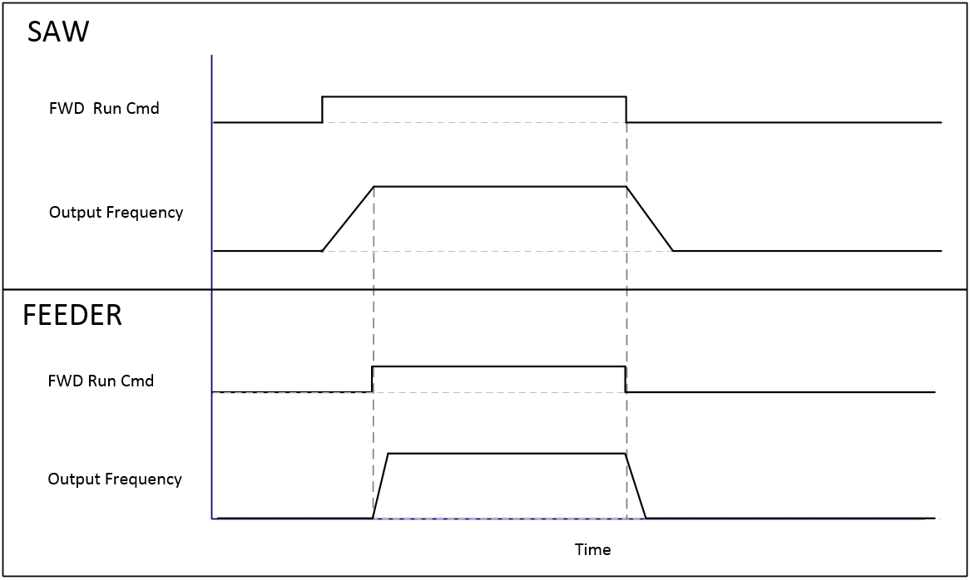
DWEZ Program sequence
1. The saw should not start if the feeder is not ready.
2. Run command for feeder should be given when the saw is at set speed.

Slide 12
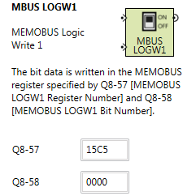
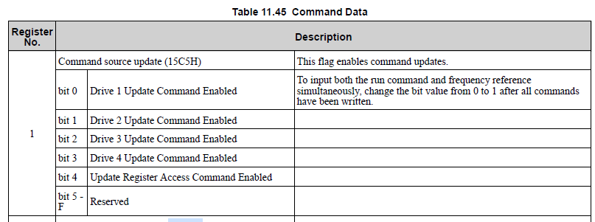
DWEZ Programming – establish membus communication
Notes:
Drive Update Command must be enabled. Otherwise the Communication to the Slave is not activated.

Slide 13
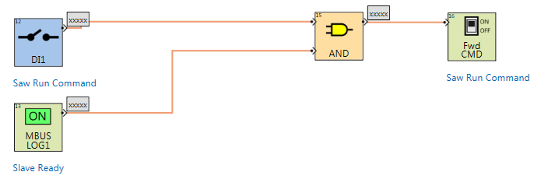
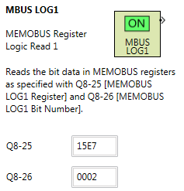
DWEZ Programming

Slide 14
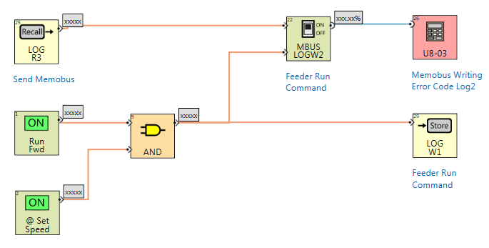
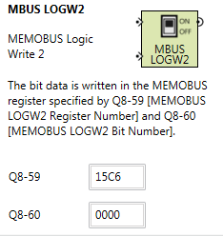
DWEZ Programming

Slide 15
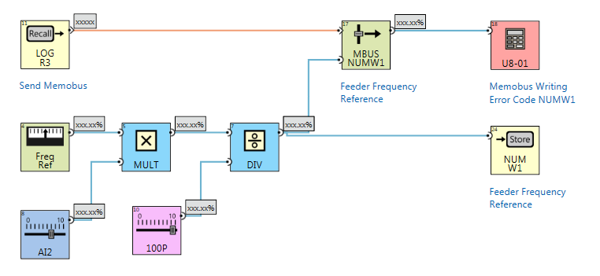
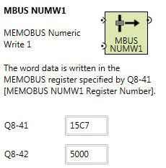
DWEZ Programming
Notes:
Important is that 100.00 * 5.00 = 50000.00 DWEZ is calculating with Integer not Floating
So it needs to be divided by 100.00 or you have to use MULP this block directly divides by 100.00
Also the Frequency Reference needs to be scaled from 100% to 5000 which is 50.00Hz in the Register 15C7

Slide 16
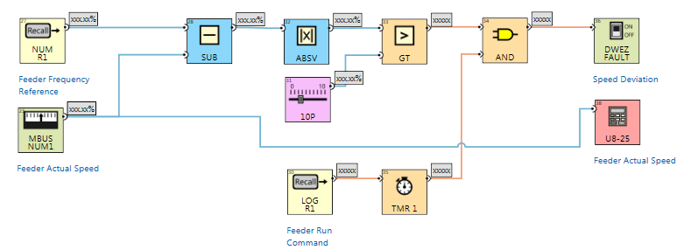
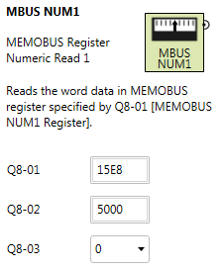
DWEZ Programming
2sec delay
Notes:
Feeder Actual Speed can be read from 15E. But be Carefull it also needs to be scaled to 5000 -> 50.00Hz =100%

Slide 17
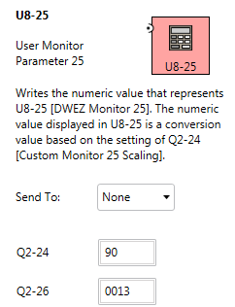
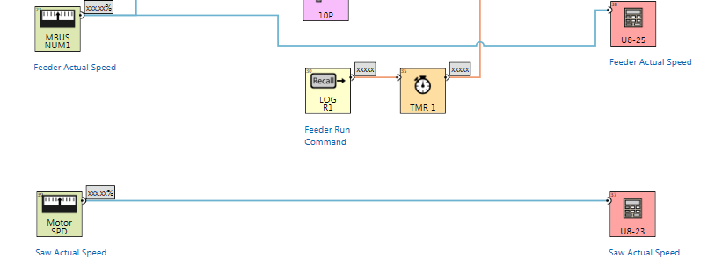
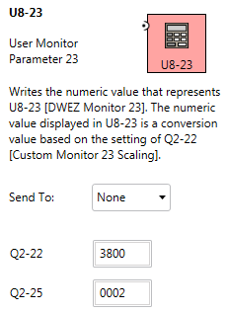
DWEZ Programming
Notes:
Feeder
Q2-24= 100% = 90 Q2-26= 0013 = m/s
SAW
Q2-22= 100% = 3800 Q2-25= 0002 = RPM

Slide 18
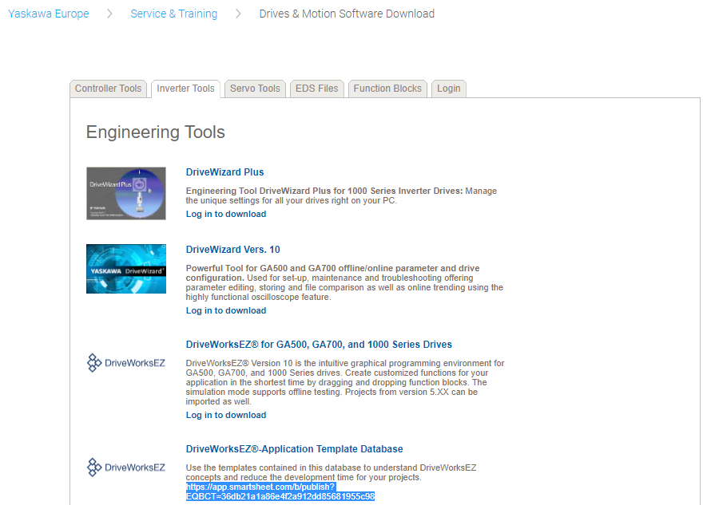
DWEZ Project library
https://app.smartsheet.com/b/publish?EQBCT=36db21a1a86e4f2a912dd85681955c98
Notes:
Feeder
Q2-24= 100% = 90 Q2-26= 0013 = m/s
SAW
Q2-22= 100% = 3800 Q2-25= 0002 = RPM

Slide 19
DWEZ Speed sequence – live demo
Notes:
Feeder
Q2-24= 100% = 90 Q2-26= 0013 = m/s
SAW
Q2-22= 100% = 3800 Q2-25= 0002 = RPM

Slide 20
What is your Drive Works EZ application?

